Slide 1

SoundScout
Welcome to SoundScout. Our mission is to enhance your live music experience by delivering logistical and aesthetic information about your favorite artists. Here you can listen to your favorite artists most popular tracks, discover up-to-the-minute perspectives, and find information about live shows. We believe that live music is about feeling indescribable moments. We aim to make space for those moments. Whether you road-trip across country to catch every show of your favorite band or you plan to escape to the city for the evening, SoundScout will help you find your way.

Slide 2

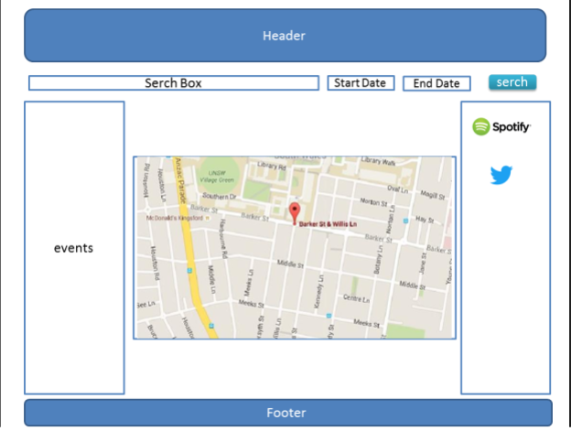

Slide 3

Technologies
Model
APIs – TicketMaster, Google Maps,
Twitter, YouTube
Firebase
View
Bootstrap, Googlefonts, Okay-Nav
Controller
Javascript, JQuery

Slide 4

STRENGTHS
Modularity in the code base to add functionality
Fluid Responsive Design
WEAKNESSES
Opportunities
Lack of Authorizations
Firebase Analytics
Dependence on multiple/integrated APIs
Location based searches
Threats
Ticketmaster’s Robust API
Unforeseeable changes to API rules
(see Spotify)

